Slide 1
A Review of DeepSeek Models' Key Innovative Techniques
Chengen Wang, Murat Kantarcioglu

Slide 2
Presented by:
Iqra Anwar
21L-6038
Hadeed
21L-6023
Saboor Ahmed
21L-1810
Muaaz
21L-5467

Slide 3
What’s the paper about?
This paper is about DeepSeek-V3 and DeepSeek-R1 — two powerful open-source Large Language Models
The goal is to explain why DeepSeek is so effective. It looks at the innovative techniques that make it work well.
Techniques:
Transformer Improvements
Multi-Head Latent Attention (MLA)
Mixture of Experts (MoE)
Multi-Token Prediction
Group Relative Policy Optimization (GRPO)
Training Methods
Hardware and Software Co-design

Slide 4
Transformer Improvements

Slide 5
MultiHead Latent Attention
How traditional attention works (Multi-Head Attention - MHA)
Why it has problems (KV cache and memory cost)
How MLA improves on it

Slide 6
MultiHead Latent Attention
Transformers learn by “attending” to (or focusing on) different words (tokens) in a sentence.
This attention process happens using three vectors for every word:
Query (Q) – What am I looking for?
Key (K) – What do I contain?
Value (V) – What information should I give if I'm selected?
The model compares the Query of a word to the Keys of all other words to decide which ones are important, and then combines their Values to get the final result.

Slide 7
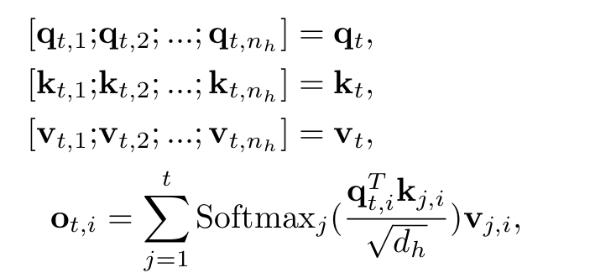
MultiHead Latent Attention
What is Multi-Head Attention (MHA)?
Instead of using just one Q-K-V comparison, transformers use multiple “heads” to learn different types of relationships. Each head looks at different things.
Think of it like this:
Head 1 might learn grammar rules.
Head 2 might focus on object references.
Head 3 might pay attention to word order.
What's the Problem with Standard MHA?

Slide 8
MultiHead Latent Attention
MLA is a smarter way to reduce memory:
Instead of storing full K and V for every token, MLA compresses the Key and Value information into a smaller “latent” representation.
It then uses that compressed form to compute attention — saving memory without sacrificing quality.
The model first projects the K and V into smaller “latent” spaces and caches only the compressed versions. Then it uses them during attention calculations.

Slide 9
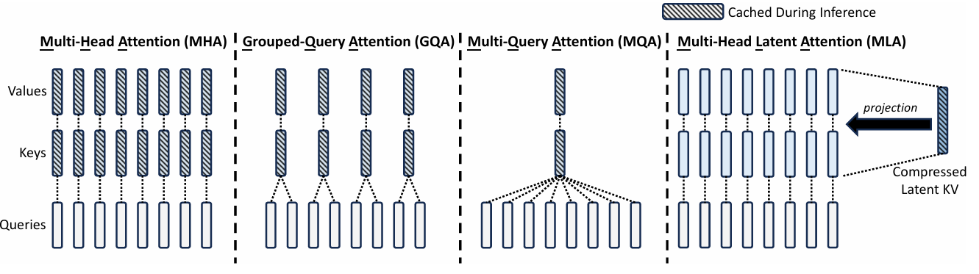
MultiHead Latent Attention

Slide 10
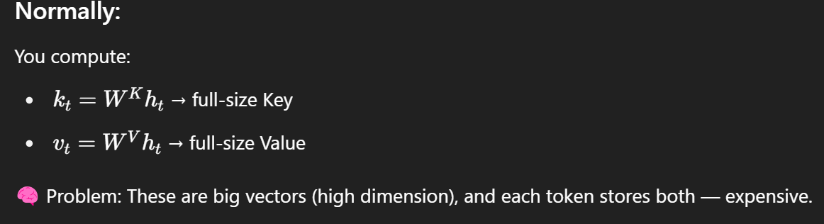
Low-Rank Key-Value Joint Compression
In transformers, each token gets a Key and Value vector. In large models, storing all these vectors for every token and every head uses a lot of memory (especially during inference).
Instead of creating separate full-size Key and Value vectors:
👉 Compress both into a single, small vector using a low-rank matrix. This shared vector is then used to reconstruct approximate Key and Value vectors when needed.

Slide 11

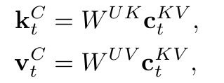
Low-Rank Key-Value Joint Compression
Compress the token embedding​ into a small vector:
Later, reconstruct approximate keys and values from this latent vector:
✅ Now you only store 1 small vector per token, instead of 2 big ones (Key + Value).

Slide 12

Decoupled Rotary Position Embedding
DeepSeek-V2 utilizes the Rotary Position Embedding (RoPE)
W^(uk) will not be absorbed into WQ, leading to significant computational cost during inference.

Slide 13
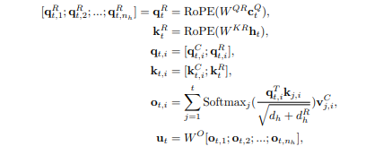
Decoupled Rotary Position Embedding
To address the issue, DeepSeek-V2 proposes to decouple RoPE into a separate set of queries and keys:

Slide 14
Mixture of Experts (MoE)

Slide 15
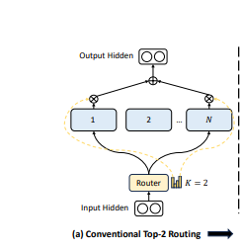
Mixture of Experts (MoE)
Fine-grained Expert Segmentation: More flexible expert selection.
Shared Expert Isolation: Capture common knowledge.
Load Balancing:
Expert-level and Device-level balancing
Auxiliary-loss-free methods

Slide 16
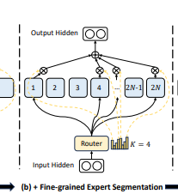
Fine-grained Expert Segmentation
Each FFN is split into m "atomic experts" by dividing its hidden dimension.
Total experts increase to mN (each original expert split into m parts).
Activated experts per token increase to mK.

Slide 17
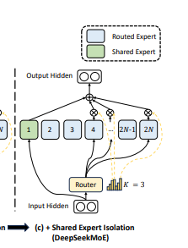
Shared Expert Isolation
Ks experts are reserved as shared experts, activated for all tokens.
These handle universal patterns (e.g., grammar rules, syntax).

Slide 18
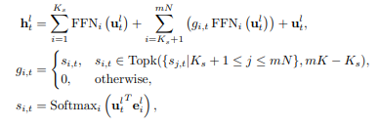
DeepSeekMoE architecture
Total number of routed experts Nr is reduced to mN − Ks
The number of routed experts for each token is mK − Ks.

Slide 19
Load Balancing
Problem:
Expert-Level Imbalance
Some experts are overused ("hot experts"), while others are underused, leading to inefficient training.
A few experts handle most tokens, causing redundancy and poor generalization.
Device-Level Imbalance
Experts distributed across devices may cause uneven computational loads or high inter-device communication costs.

Slide 20
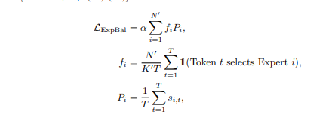
Load Balancing
The expert-level balance loss is formulated as follows.

Slide 21

Sequence-Wise Auxiliary Loss
Bias-Adjusted Routing
Add a bias term bi to each expert’s affinity score si,t

Slide 22
Multi-Token Prediction

Slide 23
Multi-Token Prediction
Predict multiple next tokens, not just one.
Improves sample efficiency during training.
Increases training overhead, but boosts final performance.
Shared embeddings and output head.
Reduces computation through shallow layer at MTP modules.

Slide 24
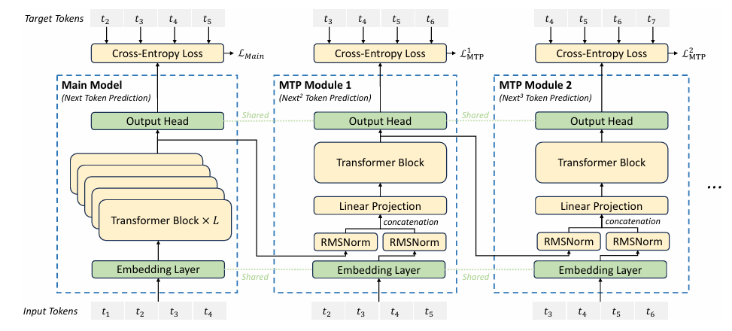

Slide 25
Co-design of Algorithms,Frameworks and Hardware

Slide 26
Co-Design of Algorithms
DualPipe:
Mixture-of-Experts (MoE) models across multiple GPUs (communication overhead)
Overlaps computation and communication to eliminate bottlenecks.
Overlaps forward computation, backward computation for inputs, backward computation for weights, and communication.
Uses GPU SM (Streaming Multiprocessor) resources smartly.
Micro batch processing.
2 model copies.
Cut in half.

Slide 27
Co-Design of Algorithms
FP8 Mixed Precision Training:
GEMM in FP8 with selective higher-precision components.
Higher efficiency with no loss in model quality.
Fine-Grained Quantization.
High-Precision Accumulation

Slide 28
Reinforcement Learning Techniques in DeepSeek-R1-Zero and DeepSeek-R1

Slide 29
What is Reinforcement Learning? (Context of LLMs)
Reinforcement Learning is typically used during the fine-tuning stage, after initial pretraining of the language model.
A set of prompts is passed to the model; the generated outputs are evaluated by a reward model or human feedback.
The reward signal is used to compute a loss, which is then back propagated to update the model’s parameters.

Slide 30
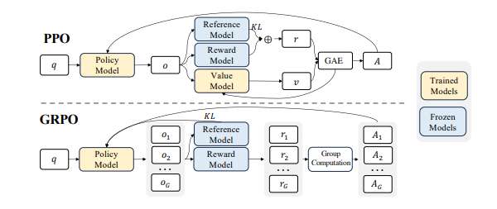
Group Relative Policy Optimization

Slide 31
Post-Training Reinforcement Learning
DeepSeek-R1-Zero: rained using only the GRPO algorithm for reinforcement learning.
DeepSeek-R1: Fine-tuned in four distinct stages:
Cold Start : Fine-tuned DeepSeek-V3 with thousands of long Chain-of-Thought (CoT) samples.
Reasoning-Oriented RL : Applied GRPO algorithm to enhance reasoning abilities.
Rejection Sampling & SFT : Collected 600k correct reasoning samples via rejection sampling, plus 200k non-reasoning samples from DeepSeek-V3 or its SFT dataset.
RL Alignment :Improved alignment with human preferences by enhancing helpfulness, harmlessness, and reasoning quality.

Slide 32
Discussion and Conclusion

Slide 33
Discussion and Conclusion
Transformer Architecture Improvements:
Enhanced attention (MLA) and FFN (MoE) modules improve model effectiveness and efficiency. Future work includes deeper analysis of position embeddings and load balancing.
Multi-token prediction:
It boosts training data utilization.

Slide 34
Discussion and Conclusion
Co-Design of Algorithms, Frameworks, and Hardware:
Techniques like DualPipe and FP8 precision show the benefits of integrated model-engineering design.
Reinforcement Learning Advances:
Pure RL post-training yields strong results. GRPO reduces GPU memory usage.

Slide 35
Thank You

